Slide 1

Project Pitch: Eco-Resilient Networks Smart Deployment for the Future
Muhammad Hamza Shahab
Syed Haider Abbas Naqvi
3rd February 2025
Researching and Engineering Community Centred Software

Slide 2
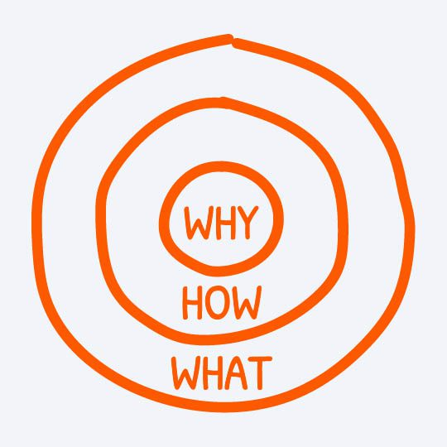

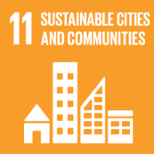


Why? The Need for Sustainable and Available Networks (Plan-Do)
Problem: In our increasingly connected world, the demand for network services is growing exponentially.
High availability is crucial for modern applications (remote surgeries, autonomous vehicles)
Sustainability (energy efficiency, low carbon footprint) is increasingly vital.
Current solutions often prioritize one over the other, creating an imbalance.
Our Belief (The "Why"):
Networks MUST be both highly available AND environmentally sustainable.
Addresses rising energy costs, environmental responsibility, and the need for seamless service delivery, aligning with UN SDGs 7, 11, 12, and 13.
Our Goal (PDSA-Plan):
To develop a system that optimizes networks for both maximum availability and minimal carbon footprint.
Our Intent (PDSA-Do):
Developing and testing novel algorithms within a robust simulation environment, using real-world data to guide our efforts.

Slide 3
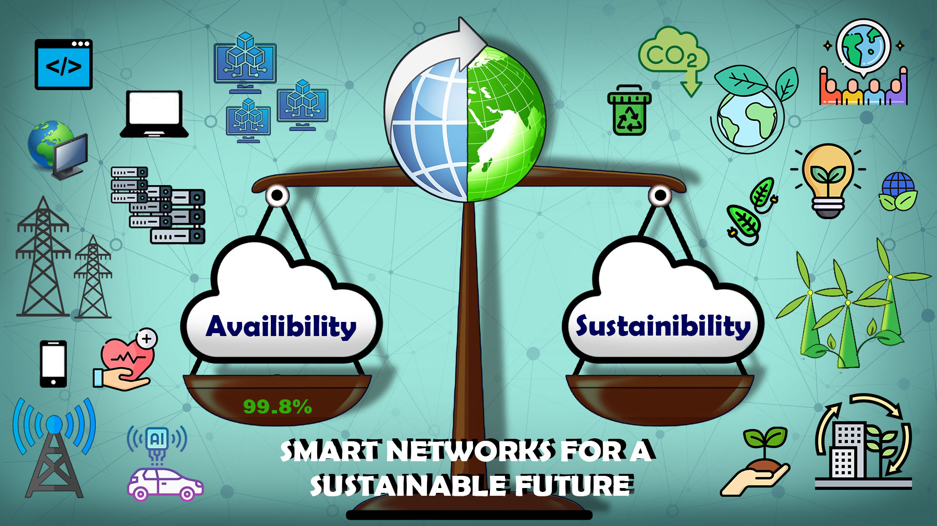

Slide 4
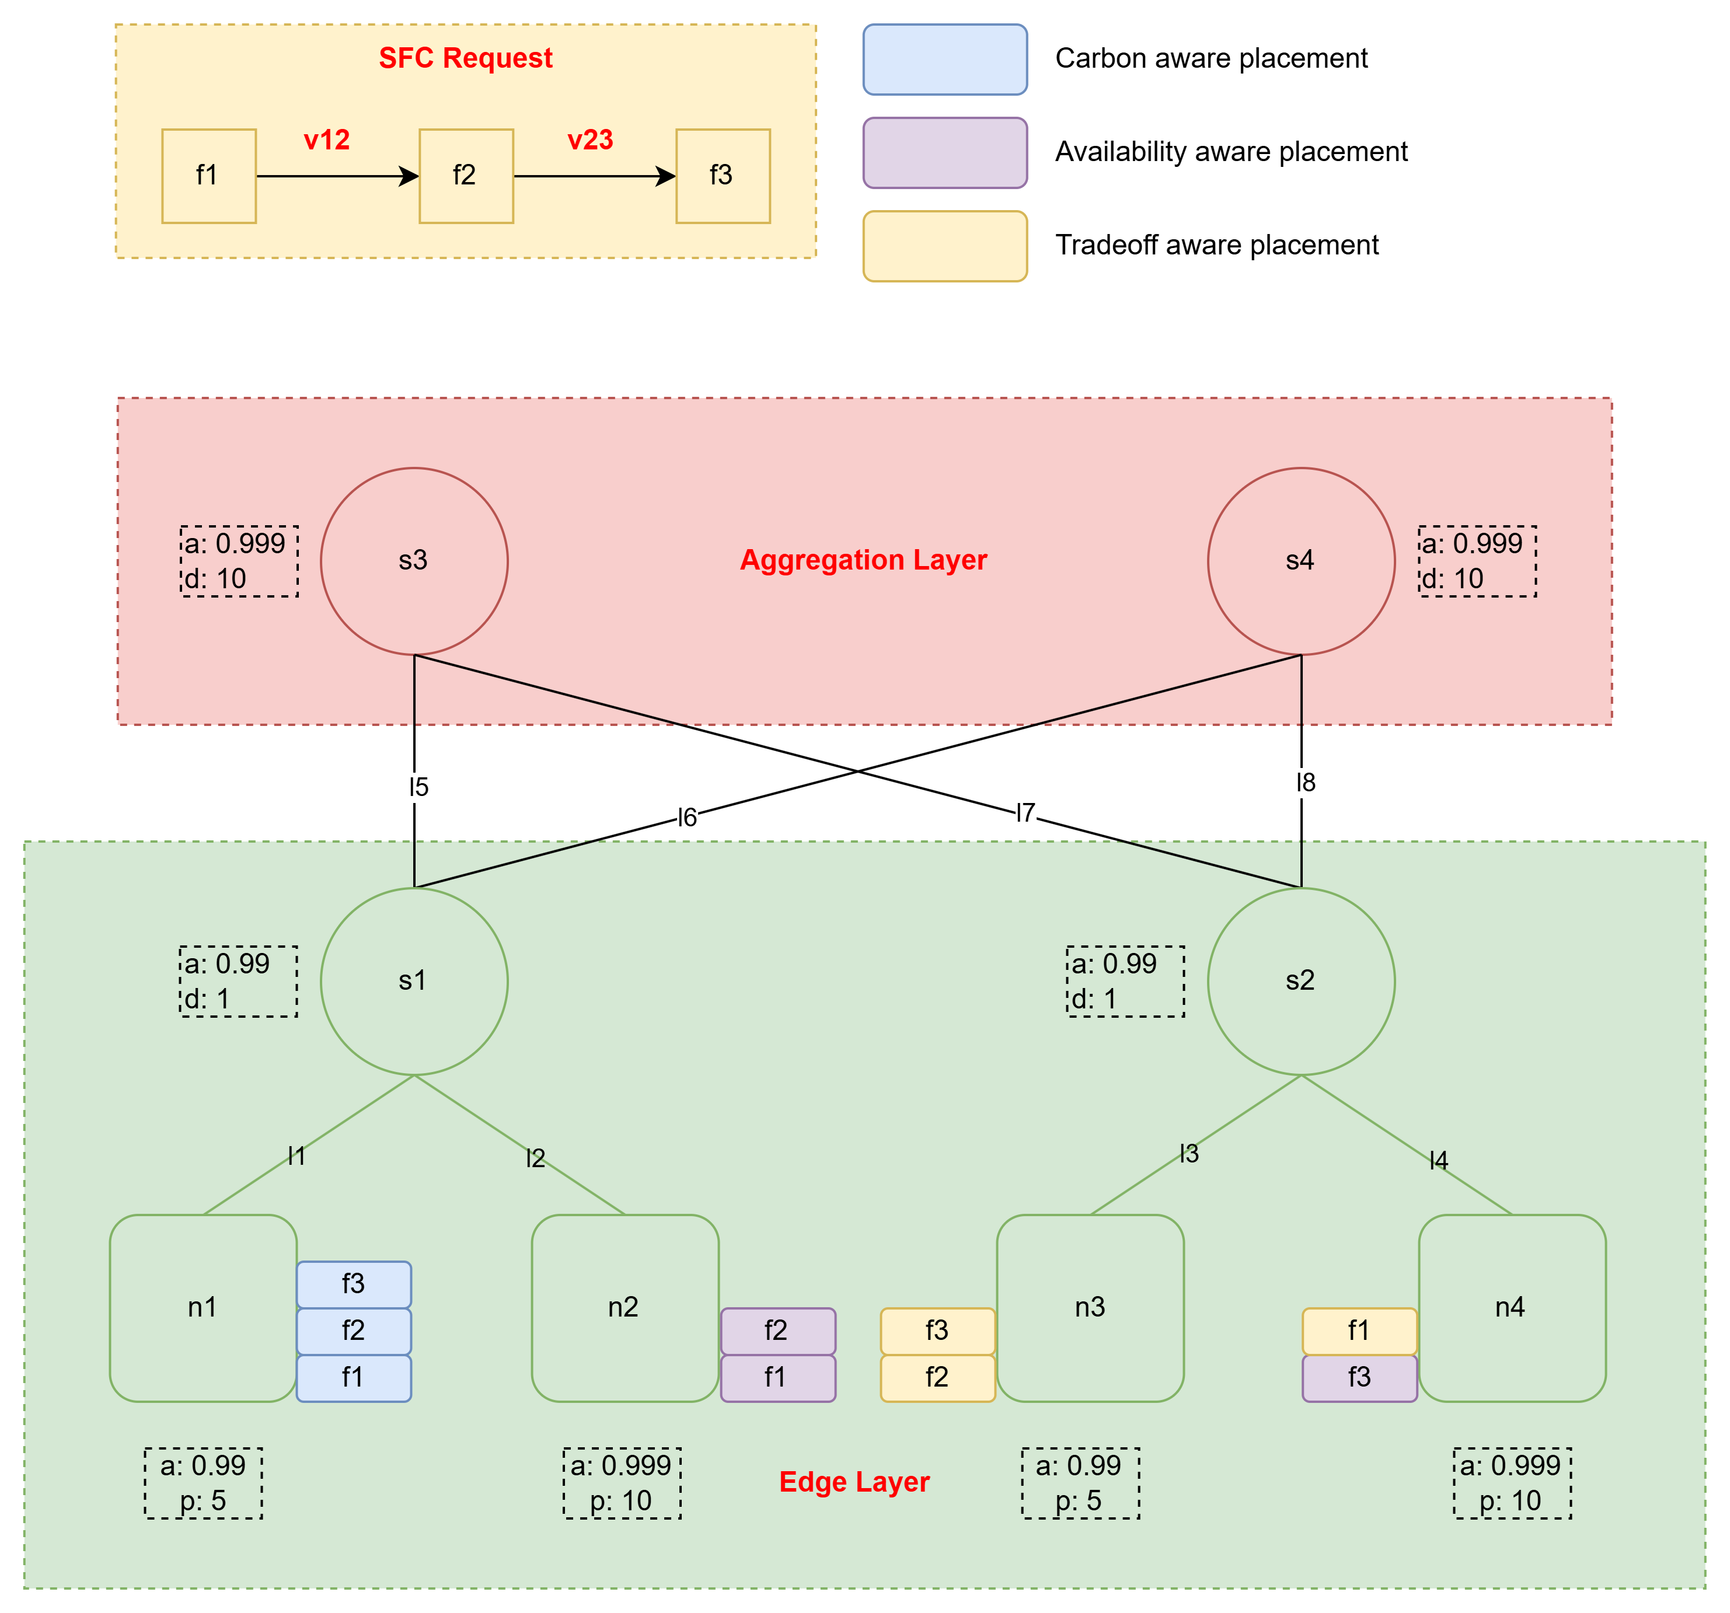
How? Optimizing Networks Allocation and Placement (Study-Act)
Our Approach: Develop and evaluate novel algorithms to optimize networks in edge-cloud environments.
Key Strategies:
Network placement policies considering both availability and carbon footprint.
Metaheuristic algorithms for intelligent network placement and redundancy.
Robust simulation using real-world data (Google Cluster Traces).
Study:
Analyze the collected data to evaluate performance
Compare results against baseline algorithms.
Identify strengths/weaknesses of each algorithm and policy.
Act:
Refine algorithms and policies based on analysis.
Document findings and prepare a research paper.

Slide 5
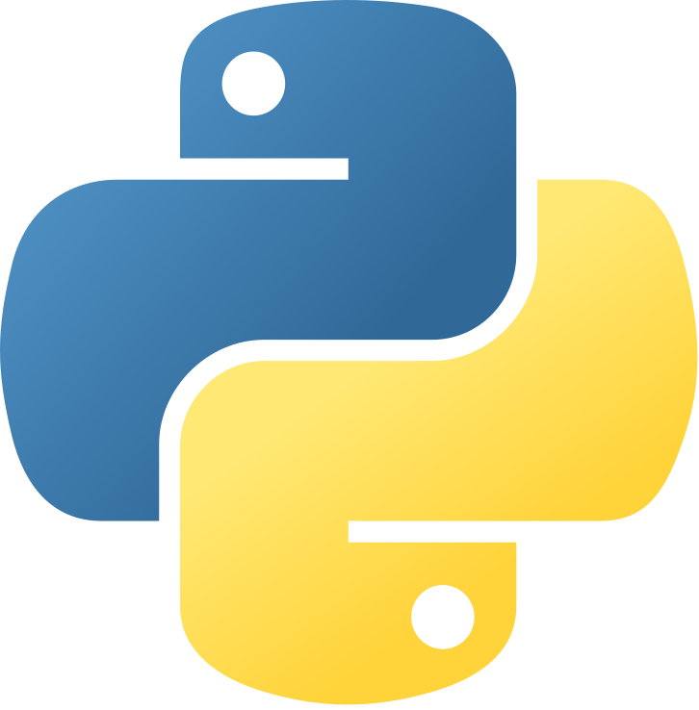



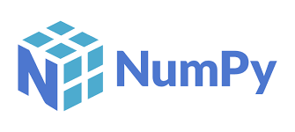

Tools and Technologies: Enabling Our Study and Action
Programming Languages:
Python (with libraries like NetworkX, NumPy, Pandas)
Optimization Libraries:
Explore libraries for implementing metaheuristic algorithms (e.g., DEAP for Genetic Algorithms in Python).
Data Visualization:
Utilize libraries like Matplotlib, Seaborn, or Plotly to create clear and informative visualizations.
Machine Learning (Future):
Explore ML (reinforcement learning) for dynamic adaptation (TensorFlow, PyTorch).
Cloud/Edge Platforms (Future):
To move beyond simulation, consider AWS, Azure, Google Cloud

Slide 6
What? Delivering Sustainable and Available Networks (Create/Iterate)
Vision: A future where seamless connectivity and environmental stewardship go hand-in-hand.
Project Deliverables:
Optimized Algorithms: For networks allocation and placement, balancing availability and sustainability.
Simulation Framework: A tool for evaluating network performance in edge-cloud environments.
Empirical Evidence: Quantitative results on availability, carbon footprint reduction, and latency
Research Contribution: A paper advancing the field of network function virtualization and sustainable computing.
Iteration:
We acknowledge that this is an iterative process.
We will use the feedback and data gathered to continuously refine our algorithms, policies, and simulation environment.

Slide 7

10
Open Questions and Seeking Feedback
Your Input Matters: Shaping the Future of this Project
Current Idea: A system that intelligently places and manages network functions, optimizing for both availability and sustainability, using advanced algorithms to make dynamic decisions.
Areas for Feedback:
Impact: Which aspects are likely to have the most significant impact (research-wise and practically)?
Technology Choices: Are there other technologies or tools you would recommend?
Alternative Approaches: Can you suggest any different approaches?
Expansion: How might this project be expanded beyond the course?

Slide 8
Thank You - Let’s Build Sustainable Networks!
Contact:
Email: msx044@uregina.ca
LinkedIn: https://www.linkedin.com/in/hamzashahab1610/
GitHub: https://github.com/hamzashahab1610

